Slide 1
HOUSE RENT APP USING MERN
TEAM MEMBERS
V SANNITH KUMAR
C S VARA PRASAD
C PAVAN KUMAR
T DHARMENDRA

Slide 2
ABSTRACT
*The demand for innovative solutions to simplify the home search and rental experience has been driven by the real estate sector's increasing interest in digital platforms.
*This project involves creating a House Rent Application utilizing the MERN stack, which includes MongoDB, Express.js, React.js, and Node.js.
*The application provides a contemporary and efficient platform for listing and renting properties, promoting seamless communication between landlords and tenants.
.

Slide 3
.
INTRODUCTION
The House Rent App is a user-friendly tool designed to simplify the process of renting and managing properties.
This application offers a straightforward and efficient way for both tenants and landlords to list properties or search for new homes.
With advanced search filters, secure payment options, and real-time communication features, the app streamlines the matching of renters with rental homes that meet their specific needs.

Slide 4
EXISTING SYSTEM
There are several limitations associated with this system that could affect its overall performance and user experience, especially if the app attracts a large user base; the MERN stack may struggle to handle high traffic and large databases without significant optimization.
The implementation of real-time features like chat and notifications may lead to performance issues if not properly managed.
Tenants can search for apartments based on location, price, and preferences on traditional rental websites, which usually enable property owners to display available rentals. However, these systems tend to be less efficient and harder to maintain because they often rely on different technologies for front-end and back-end functions.

Slide 5
PROPOSED SYSTEM
The proposed system will be built using the MERN stack
User-friendly interface:
The app offers a responsive design, easy navigation, and personalized dashboards.
Real-time scheduling:
The platform offers real-time availability, instant booking, live notifications, and messaging for efficient rental management.
Secure User Authentication and Authorization :
The platform uses JWT for secure user access and role-based authorization for landlords and tenants.

Slide 6
Payment Integration :
The platform integrates Stripe or PayPal for secure payments and allows users to track their transaction history.
Reviews and Ratings :
Tenants can leave reviews for properties and rate landlords, fostering transparency and informed decisions.
Admin Panel and Management :
The admin panel enables system management, user monitoring, and dispute resolution for landlords and tenants.
Scalability and Performance:
The platform uses MongoDB for scalable data storage and a Node.js backend for fast, efficient API services.

Slide 7
FUTURE IMPLEMENTATIONS
Advanced Search and Filtering
User Profile Customization
Mobile Application
Multilingual Support
Automated Booking and Payment Systems

Slide 8
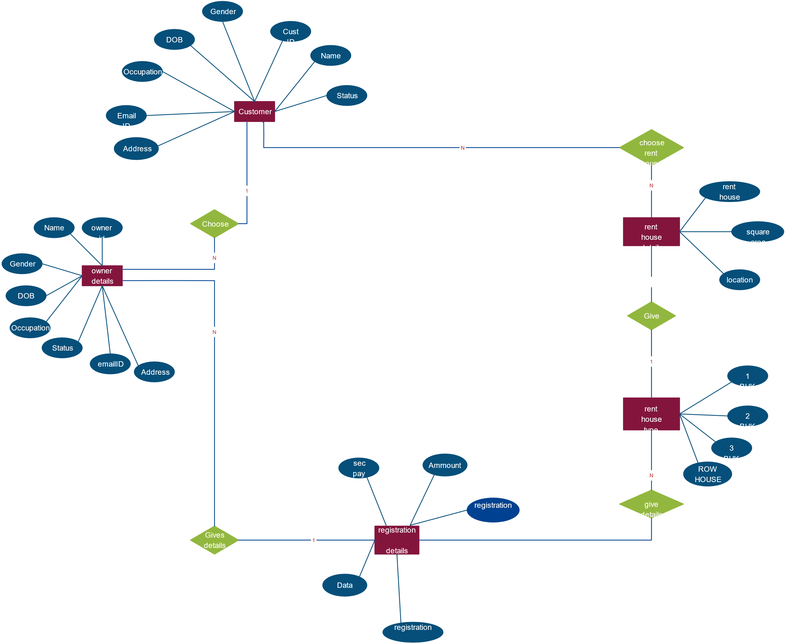
ER DIAGRAM

Slide 9
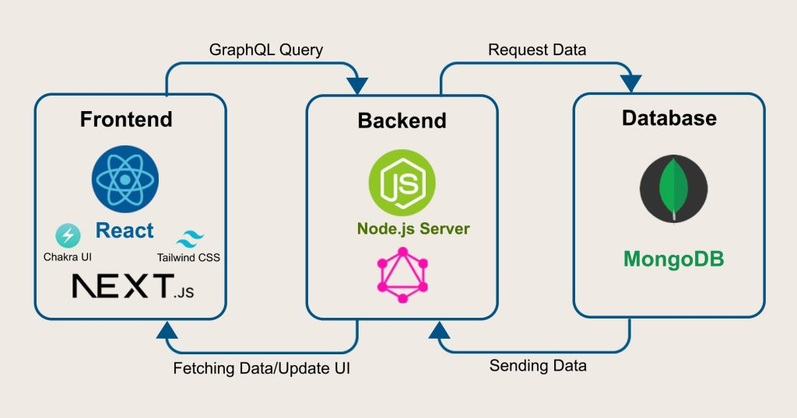
ARCHITECTURE

Slide 10
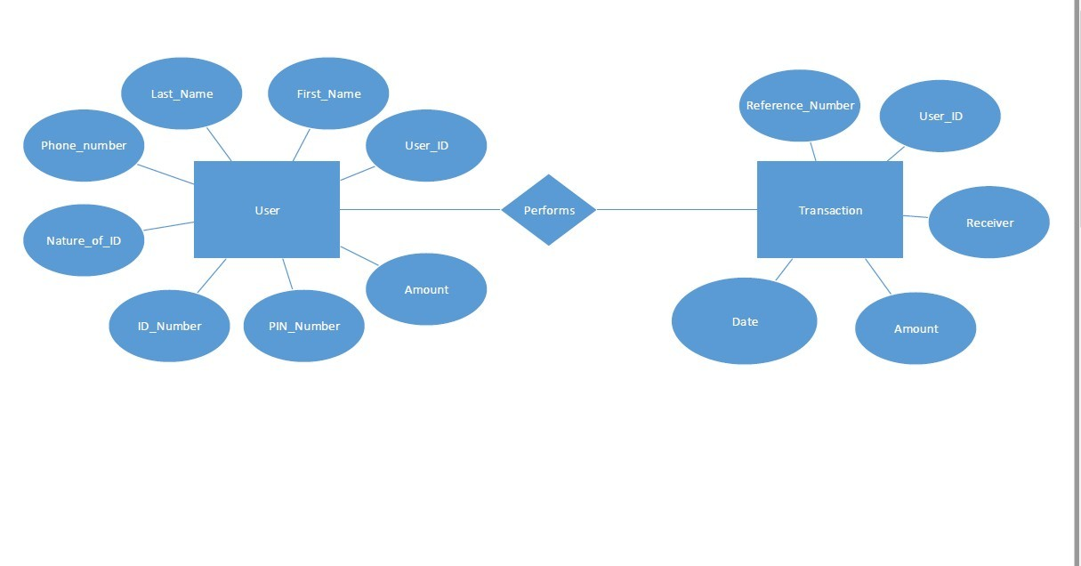
FLOW DIAGRAM

Slide 11
FRONT-END DEVELOPMENT
The frontend is built using React.js to create a responsive and interactive user interface.
Technologies Used:
React , HTML, CSS, Bootstrap.
React components handle the Booking scheduling process and user interactions dynamically. It includes components like the House Rent search page, Managing booking form, and user login/signup features.
JWT (JSON Web Tokens) is implemented to provide secure login and authentication.
Features like real-time status updates and notifications are implemented using React's state management.

Slide 12
BACK-END DEVELOPMENT
The backend of the House Rent App using Mern is built using Node.js and Server.js, providing the core functionality for managing bookings , user data, and communication between the frontend and database.
Database Design:
Users: Stores landlords/tenants’ details
Properties: Stores property details (owner, price, location)
Bookings: Manages tenant bookings
Payments: Handles payment transactions

Slide 13
BACK-END DEVELOPMENT
API ENDPOINTS:
Users: Register, login, profile management
Properties: CRUD (Create, Read, Update, Delete) for properties
Bookings: Manage bookings (create, update, cancel)
Payments: Process payments
4 Authentication JWT For user authentication Role-based Access Separate permissions for landlords and tenants

Slide 14
BACK-END DEVELOPMENT
Database Management (MongoDB):
MongoDB is used as the NoSQL database for the house rent application, storing crucial data such as user profiles, house listings, rental agreements, and user reviews.
Data is organized into collections (e.g., Users, Houses, Appointments) and is managed using Mongoose, which is a MongoDB Object Data Modeling (ODM) library.
Mongoose provides schemas to define the structure of the data, enabling data validation and ensuring smooth interactions with MongoDB.

Slide 15
INTEGRATION
The frontend (React.js) interacts with the backend through RESTful APIs. React makes GET and POST requests to the server, which processes data and returns appropriate responses.
The backend communicates with MongoDB using Mongoose for managing user profiles, house listings,bookings and reviews. API requests fetch and update this data in real-time.
The backend uses JWT tokens for secure user authentication. When users log in or sign up, their credentials are validated, and a token is returned to allow access to protected routes.

Slide 16
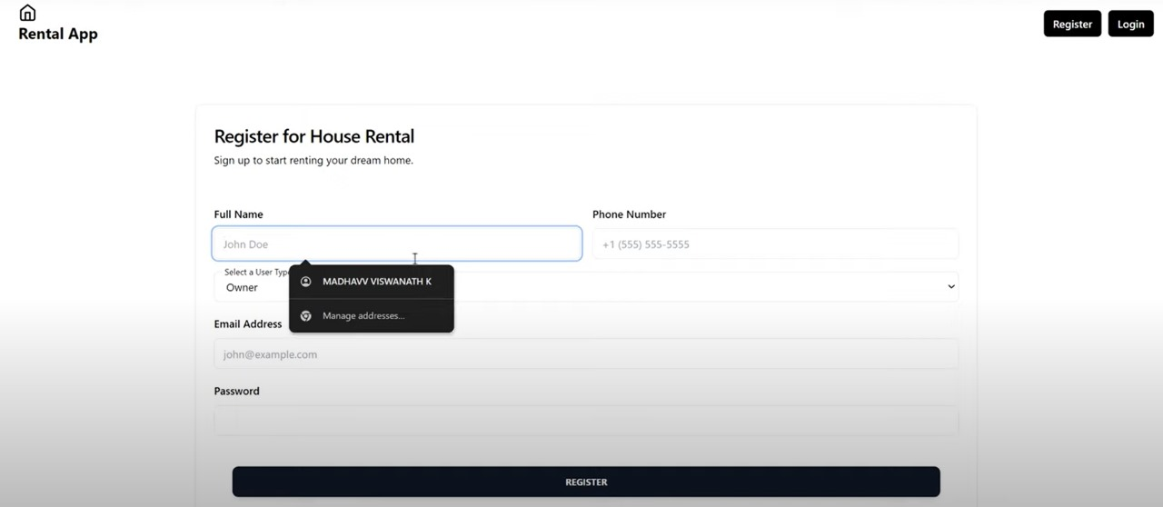
MODEL
REGISTERATION PAGE

Slide 17
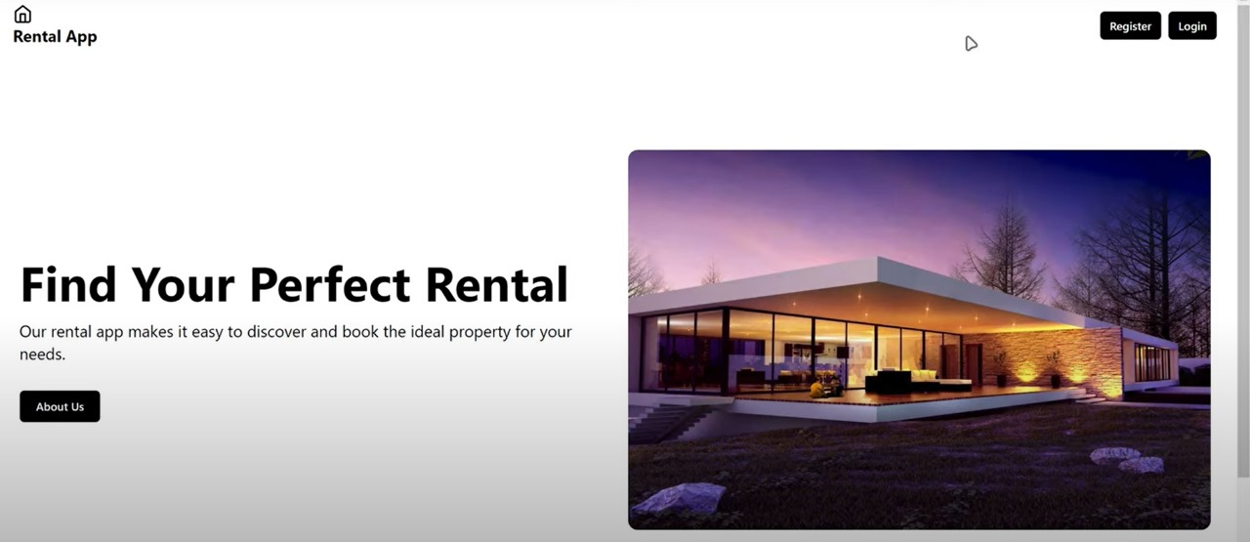
HOME PAGE

Slide 18
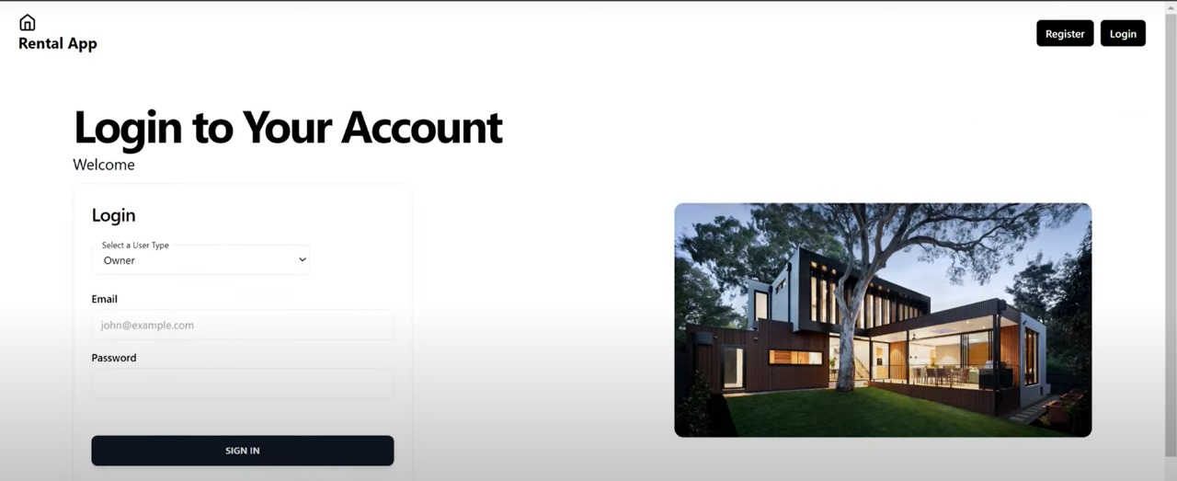
LOGIN PAGE

Slide 19
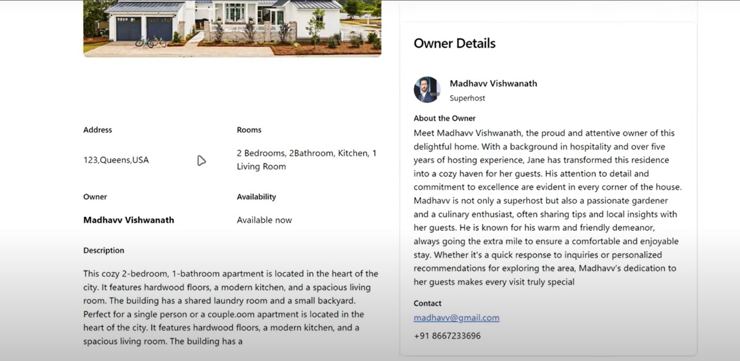
HOUSE DETAILS

Slide 20
CONCLUSION
This project, “HOUSE RENT APPLICATION USING MERN,” offers a robust solution to modernize the house rental process. It is built using scalable web technologies that enhance the user experience for both tenants and landlords while streamlining property management workflow. The application exemplifies how the MERN stack can be used to develop responsive and efficient web applications in the real estate sector. With features such as user registration, house listings, booking management, and secure authentication, it addresses the needs of users in a digital marketplace, making the house rental experience more accessible and efficient

Slide 21
THANK YOU

